Slide 1

Bangladesh University of Business and Technology (BUBT)
Course Title: Software Development II
Project Name: Teacher Assistant
Presented By:
Name | ID | Intake/Section
Jack Pritom Soren | 19201103032 | 43/01
Partho Debnath | 19201103016 | 43/01
Fayezur Rahman | 19201103017 | 43/01
Supervised By:
Shovon Roy
Lecturer
Department of Computer Science and Engineering
Summer-2021
27th November, 2021
Dept. of CSE CSE-200

Slide 2
Introduction
Teacher Assistant is software which is helpful for instructor as well as the school/college/university authorities. In the current system all the activities are done manually. It is very time consuming and costly. Our Teacher Assistant deals with the various activities related to the teachers.
There are mainly 3 modules in this software :
i. Admin Module.
ii. Instructor Module.
iii. Marks and Attendance Management.
Dept. of CSE CSE-200

Slide 3
Problem Statement
In this software we can create accounts as instructor. It has an admin panel through which he can manage the department related things. At the beginning of each semester Admin can prefer the courses and select instructors according to the department and section.
Admin will be able to add department, section and intake any time. We will save all this data in a database through the xampp server. Through this program we will add and calculate Marks of the students of each section and save it in the database. Instructors can easily login to their account and add marks and attendance. He can add marks according to the exam type he chooses.
Dept. of CSE CSE-200

Slide 4
Objectives
Stated the desired goals and objectives to address the needs. Also included the key benefits of reaching objectives.
• Every day the teacher can add class attendance of the students.
• Teachers can save student exams and assignments marks.
• Finally, teachers can see the total attendance and total mark of each student.
Dept. of CSE CSE-200

Slide 5
Requirements
Hardware :
CPU: Intel Pentium Dual Core
Minimum RAM: 2 GB
Recommended RAM: 4 GB
HDD: 200 MB
Software:
OS: Windows (32 & 64 bit)
Tools:
i) Visual Studio
ii) Xampp Server / Wamp Server
iii) MySQL Connector
Dept. of CSE CSE-200

Slide 6
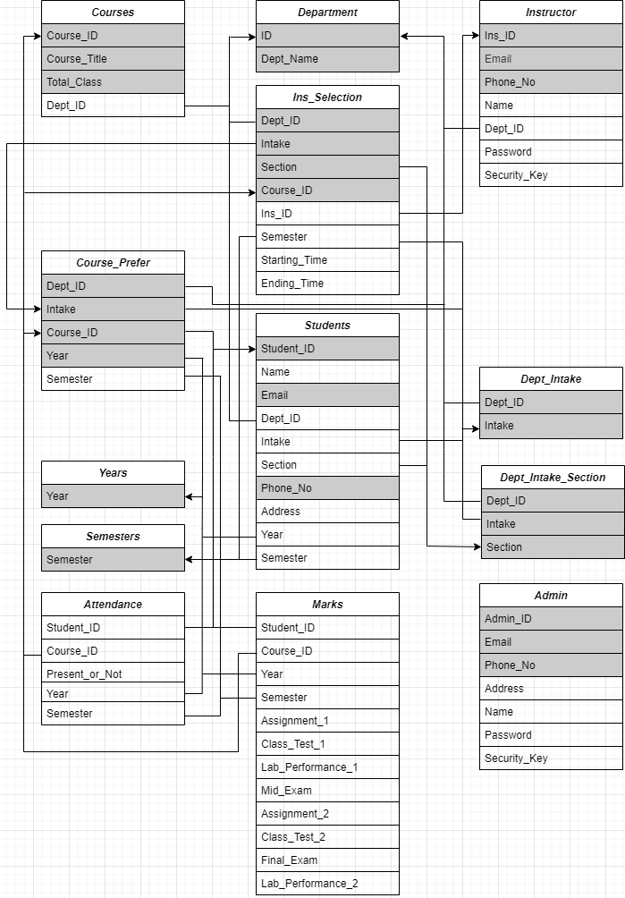
Schema Diagram

Slide 7
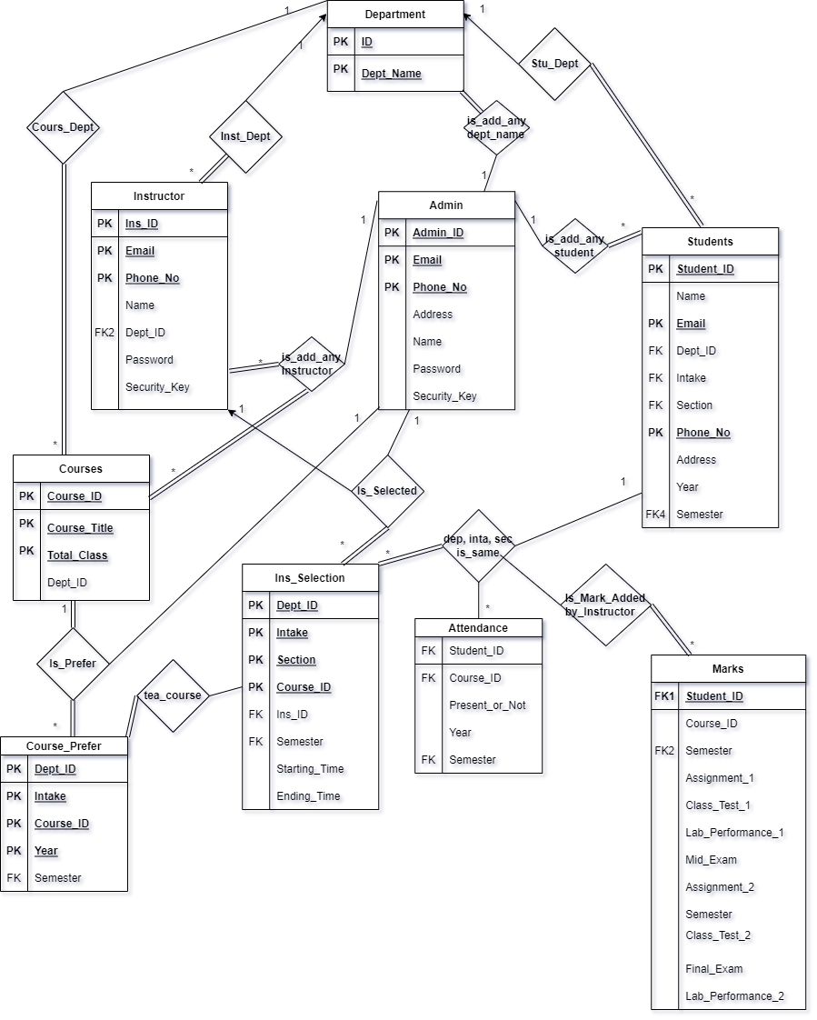
Entity Relationship(ER) Diagram

Slide 8

Login Interface
Dept. of CSE CSE-200

Slide 9
Admin Interface
Dept. of CSE CSE-200

Slide 10
First Login Interface
Dept. of CSE CSE-200

Slide 11
Instructor Panel
Dept. of CSE CSE-200

Slide 12
Recovery Account Interface
Dept. of CSE CSE-200

Slide 13
Future Plan
We know that C# program has lots of features. So, our future plan is to build this project as Online using ASP.NET (C# Framework). In future we want to add more features like
• A Dedicated module for Student.
• A Dedicated module for Intake In-Charge.
Dept. of CSE CSE-200

Slide 14
Thank You

